Slide 1
Predicting Iowa Housing Prices:
an Exercise in Machine Learning
William Kye, Mitchell Hung, Raj Tiwari, Tyler Williams

Slide 2
Project Overview
Objective: Predict housing prices in Ames, Iowa, using learned machine learning skills.
Notes:
mitch

Slide 3
Project Overview
Step 1
Step 2
Step 3
Step 4
Step 5
Exploratory Data Analysis
Feature Engineering
Initial Modeling
Hyperparameter Tuning
Submit to Kaggle
Parse through the data to see if any imputations or changes need to be made to the dataset
Create or modify features with which our models can more accurately predict than with the vanilla dataset
In essence: try out a bunch of different models and figure out which works best!
Based on results, tune our model hyperparameters to increase predictive power
Cross our fingers and hope for a good score
Notes:
mitch

Slide 4
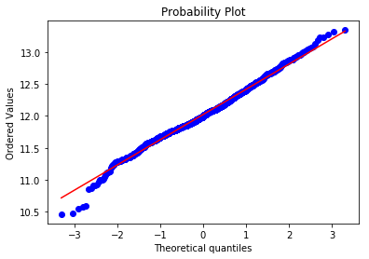
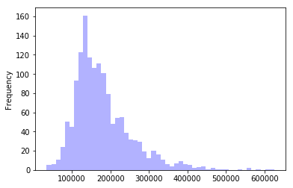
Target Variable
Target Variable - Housing
Notes:
Willie

Slide 5
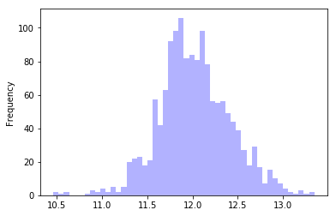
Target Variable
Log of Sale Price

Slide 6
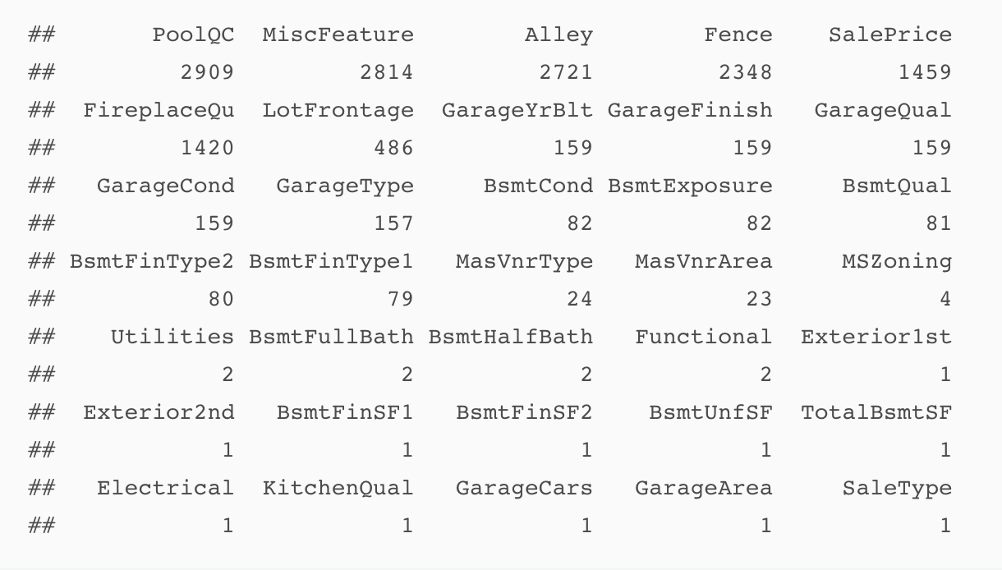
Missing Data

Slide 7
Missing Data
Missing Data Categories
Type of Missing | Variables
NA to Zero | Basement Quality, Basement Condition, Fireplace Quality, etc
Missing At Random | Lot Frontage
Missing Due to Coding of Variable | Garage Year Built

Slide 8
Missing Data
Garage Year Built
Log(Sale Date - Garage Year Built)
NA to largest date because, in predicting sale prices, having no garage is likely similar to have a very old garage.
Lot Frontage
Multiple Imputation (5 imputatations, used all predictors)

Slide 9
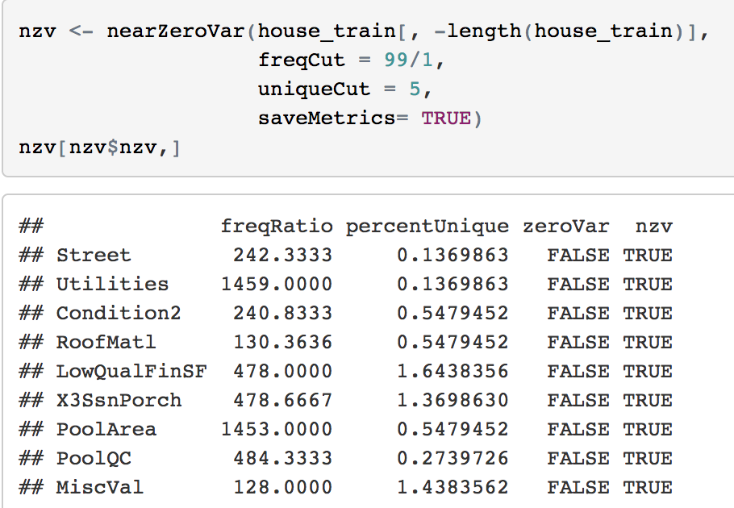
Feature Engineering
Dropped Variables with little variation

Slide 10
Feature Engineering
Log plus one
Square footage variables
Ordinal variables
Variables coded on ordinal scale (poor - excellent)
Nominal variables
Reduce number of groups in a variable (MSSubClass into one story, 2 story, projects, duplex)

Slide 11
Initial Modeling and Hyperparameter Tuning

Slide 12
General Approach to Modeling
Purpose: To identify a model or a suite models which minimizes the Root Mean Squared Error (RMSE) when predicting home prices.
Work through the bias-variance trade-off hands on and identify the ‘best’ approach for this prediction problem.

Slide 13
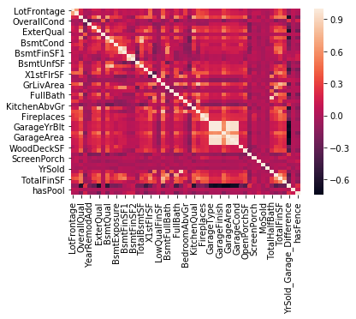
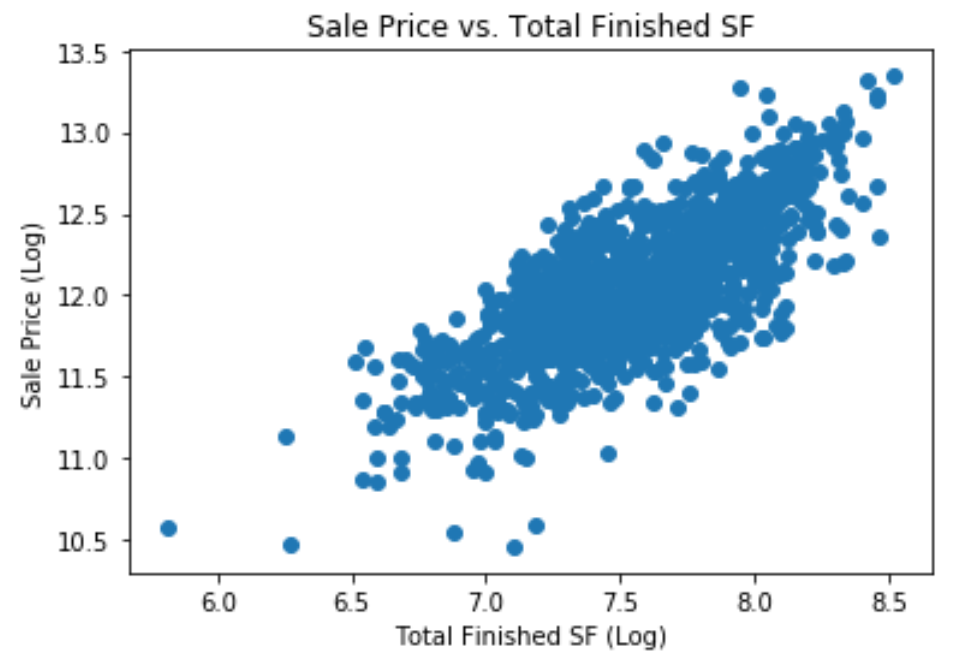
Exploratory Data
Analysis

Slide 14
Reducing Multicollinearity
Using a correlation plot (and Excel!), we identified multicollinearity in our feature set and dropped redundant variables.
Features Dropped/Additional Feature Engineering:
Add Overall Quality Feature 4. Limited bathroom count features to two
Drop GarageCond, GarageFinish, etc. 5. Drop Lot Frontage (correlated with Lot Area)
Keep only Total Finished SF 6. Drop AbvGrndRoomSize (corr. w/TotRmsAbvGr)
We ended proceeding with two sets of features throughout our ML learning expedition, the ‘complete’ feature set (172 features), and a dataset controlled for Multicollinearity (149).
Notes:
Raj

Slide 15
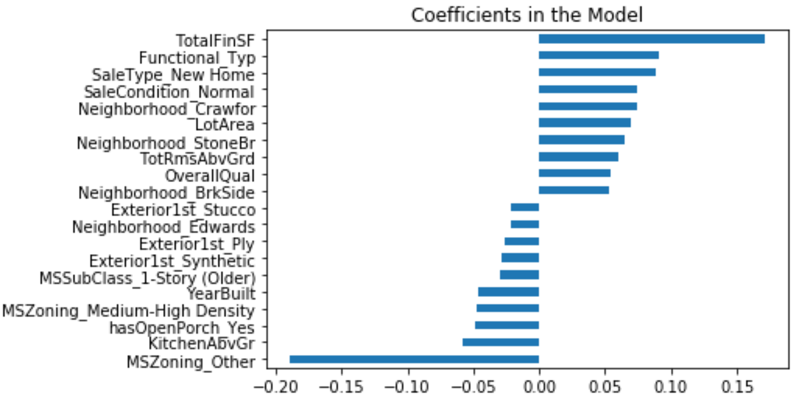
Lasso Regression
Why Lasso?
With 172 features, we viewed Lasso as an efficient method to control for multicollinearity.
Supports the identification of features that are most critical in predicting home prices.

Slide 16
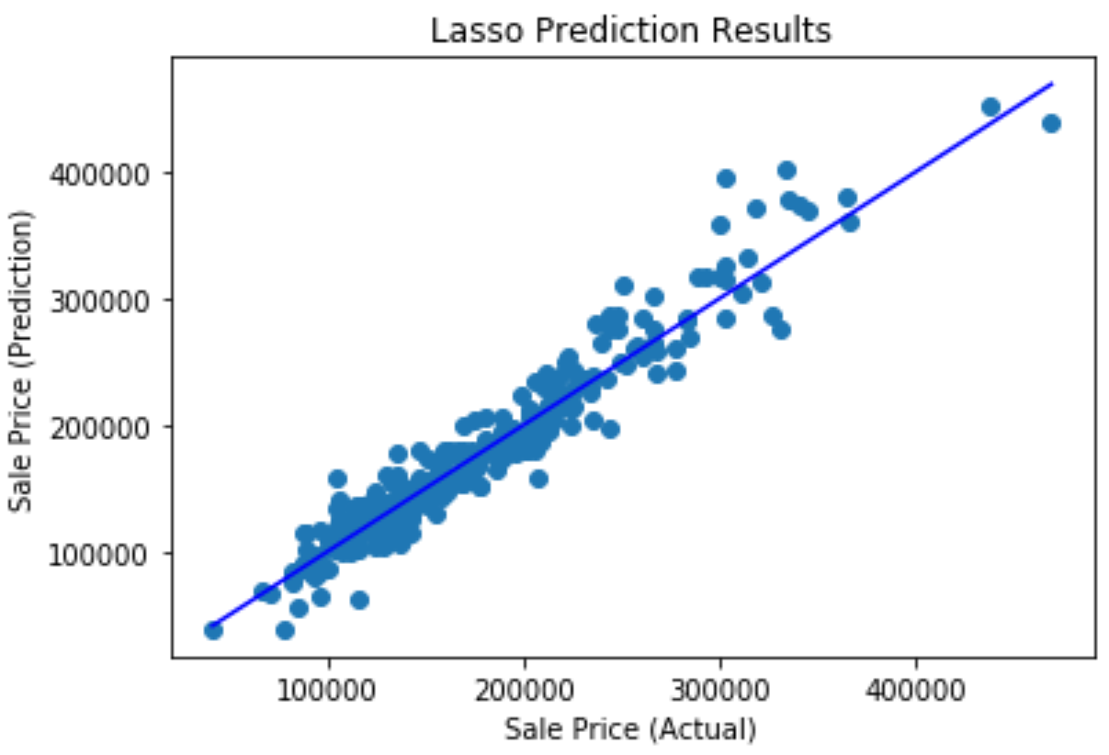
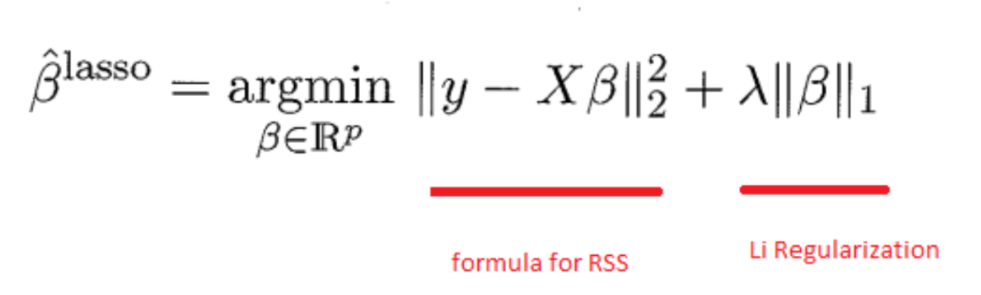
Lasso Regression
Used GridSearchCV, with 5-fold cross validation to derive the best parameters:
Alpha: 0.00048413
RMSE: 0.119485
Best Score: 0.9154837

Slide 17
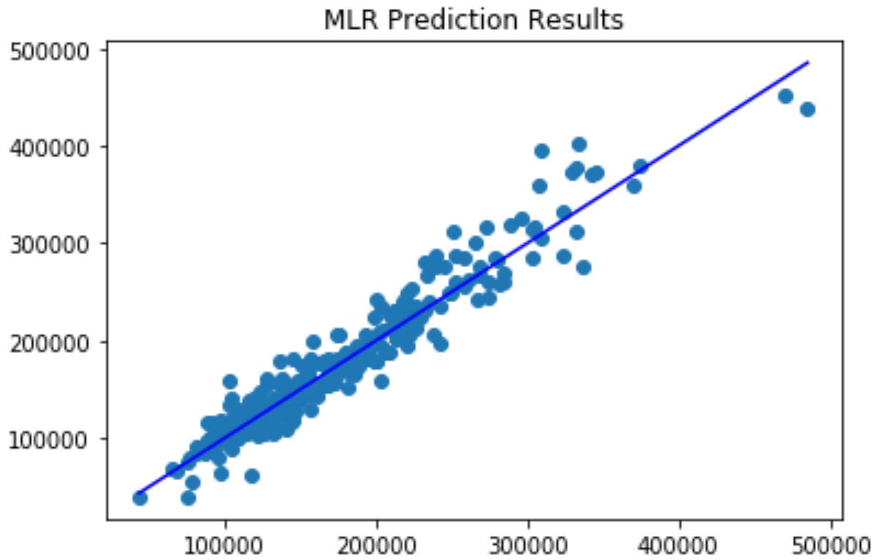
Multiple Linear Regression
The team took a unique approach towards MLR. What was it and Why?
We used the coefficients identified from L1 regularization as significant (i.e. not shrunk to 0).
Due to its superior performance, we felt like Lasso was noteworthy in terms of identifying the features important for our prediction - perhaps more better than our own intuition!
MLR Results: RMSE (.1203)
Notes:
Raj, Mitch

Slide 18
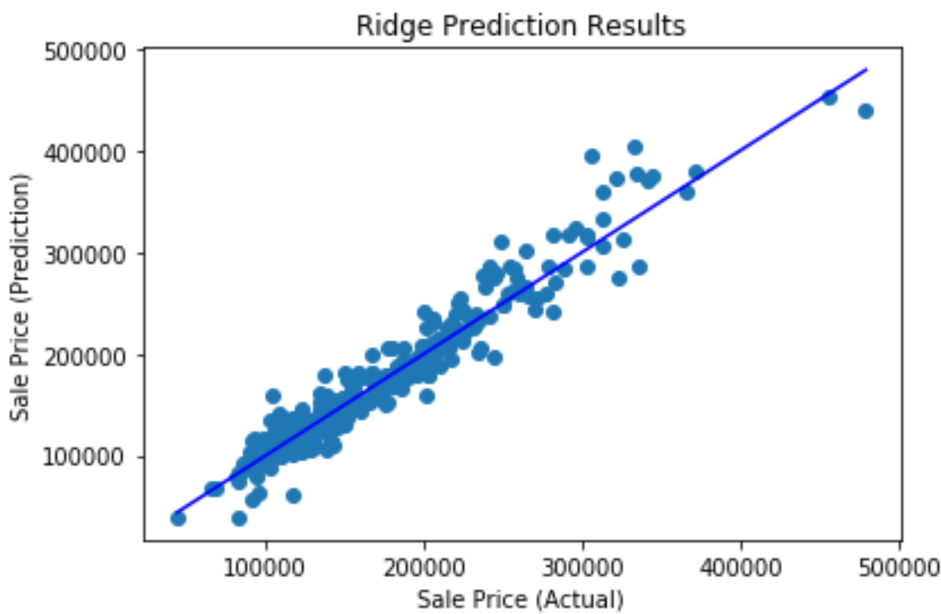
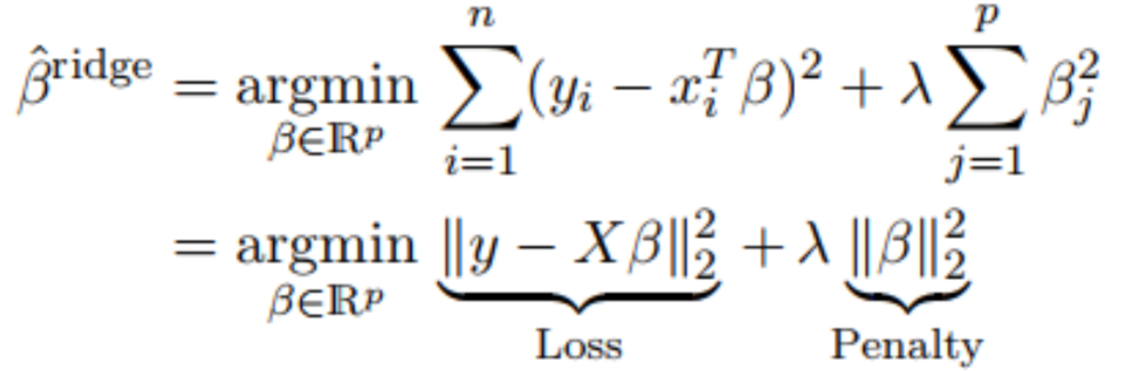
Ridge Regression
Ridge Results (Alpha: 9.4813, RMSE: 0.1207, Best Score: 0.9157)
L2 Regularization helps account for the natural collinearity found in our feature set. As the alpha increases, the complexity decreases, preventing over-fitting.
Through our analysis, we were surprised to find a better score with Lasso than Ridge. We thought the L1 regularization works best when there way more than only 172 features.

Slide 19
Random Forest
Parameter | Description | Value
max_depth | maximum depth of a tree | 16
n_estimators | number of trees in the forest | 144
min_samples_leaf | minimum number of samples to be at a leaf node | 5
min_samples_split | minimum number of samples to split an internal node | 10
max_features | number of features to consider when looking for the best split | sqrt
Used GridSearchCV with 5 fold cross validation to find the best parameters
Best Score: 0.905
RMSE: 0.12
Notes:
Tyler

Slide 20
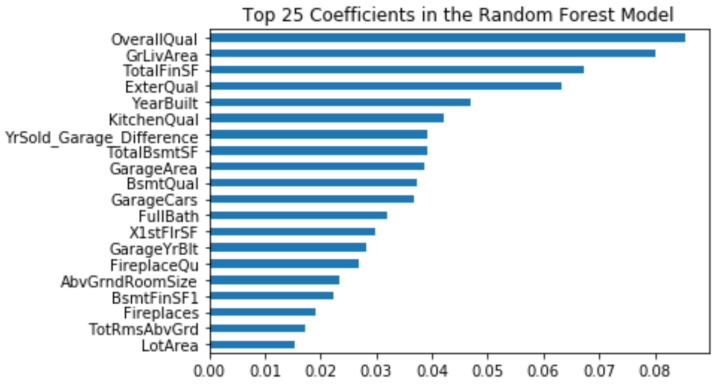
Random Forest
Notes:
Tyler

Slide 21
Gradient Boosting Regression
Parameter | Description | Value
learning_rate | learning rate of the tree | 0.0849
subsample | Fraction of samples to be used for fitting the individual base learners | 0.6
Used GridSearchCV with 5 fold cross validation to find the best parameters
Best Score: 0.911
Notes:
Tyler
Loss Function: least squares regression
learning_rate : the learning rate shrinks the contribution of each tree by learning_rate. There is a trade-off between learning_rate and n_estimators
subsample: the number of samples to be used for fitting the individual base learners
n_estimators = 400

Slide 22
Ensembling

Slide 23
Ensembling by Average
What it sounds like: outputting housing prices using multiple models, then taking the mean
alpha:
9.4813
alpha: 0.00048413
learning_rate:
0.0846
subsample:
0.6
See slide 22 for hyper-
parameters
Ridge Regression
Lasso Regression
Average
Final Result
Gradient Boosting Regression
Test RMSE: 0.11668
Kaggle RMSE: 0.12582
Random Forest Regression
Notes:
Raj’s Notes for Mitch:
avg_test=((ridge_gs2.predict(X_test_orig)) + (l_gs2.predict(X_test_orig)) + (gbr_gs.predict(X_test_orig)) +
(regr.predict(X_test_orig)))/4
RMSE: 0.11668570147013792
test_prediction=((ridge_gs2.predict(test_org_features)) + (l_gs2.predict(test_org_features)) + (gbr_gs.predict(test_org_features)) +
(regr.predict(test_org_features)))/4

Slide 24
Stacking
alpha:
9.4813
alpha: 0.00048413
learning_rate:
0.0846
subsample:
0.6
See slide 22 for hyper-
parameters
Ridge Regression
Lasso Regression
n-D Matrix
MLR
Final Result
Gradient Boosting Regression
Kaggle RMSE: 0.12567
Random Forest Regression
Notes:
Mitch

Slide 25
Conclusions
General consistency among our primary models as to the strongest predictors (e.g. Total SF, Quality)
Multicollinearity Conundrum: should we disregard our advanced feature engineering which attempted to account for multicollinearity even though it performed worse
Chasing the lowest RMSE - we choose to focus on model interability rather than overemphasize the prediction power on Kaggle
Simplicity over complication - Does individual model performance vary with dataset complexity?

